Slide 3
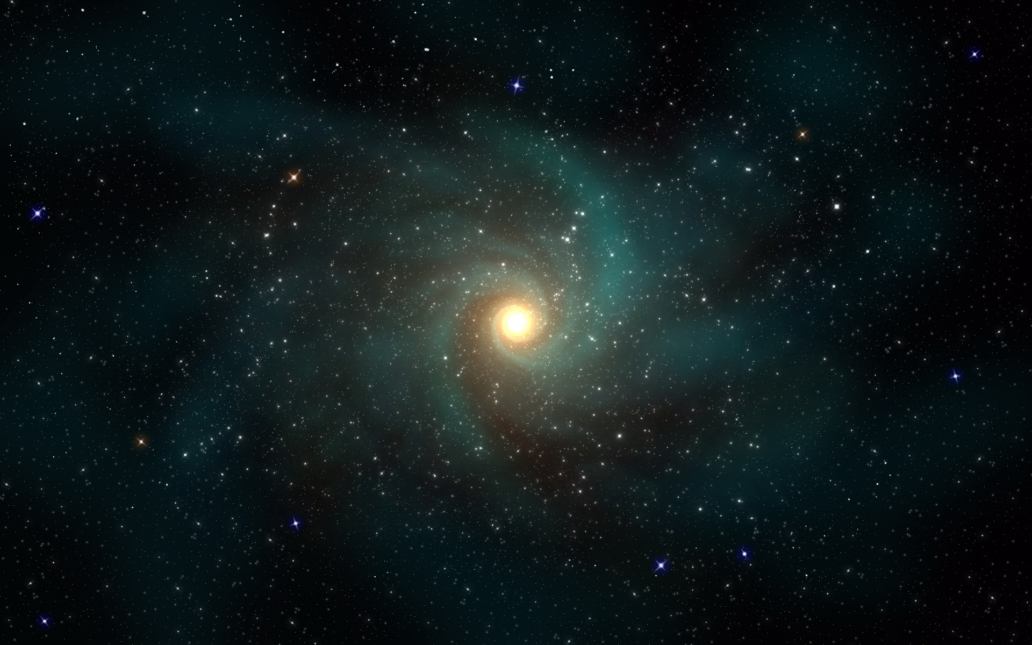
TIE!!!!
[ Press [i] for instructions]
[ Press [a] to Start ]

Slide 4
Player 1 Wins!!!!
[ Press [i] for instructions]
[ Press [a] to Start ]

Slide 5
Player 2 wins!!!!
[ Press [i] for instructions]
[ Press [a] to Start ]

Slide 6
Space Wars!
[ Press [i] for instructions]
[ Press [a] to Start ]

Slide 7
The goal of the game is to reduce your opponent’s health from 3 to 0 by shooting them or by allowing aliens on your opponent’s side to kill him. You cannot shoot aliens on your opponent’s side. You must also not allow aliens to come to close to you. There will be neutral aliens flying through the centre periodically, killing them will drop buffs which will help you if you walk over them (up to a limit depending on the buff).
a
d
Player 1 move left
Player 1 move right
Player 2 move left
Player 2 move right
0
SPACEBAR
Player 1 shoot
Player 2 shoot
[ Press [a] to Start ]

Slide 8



Slide 9




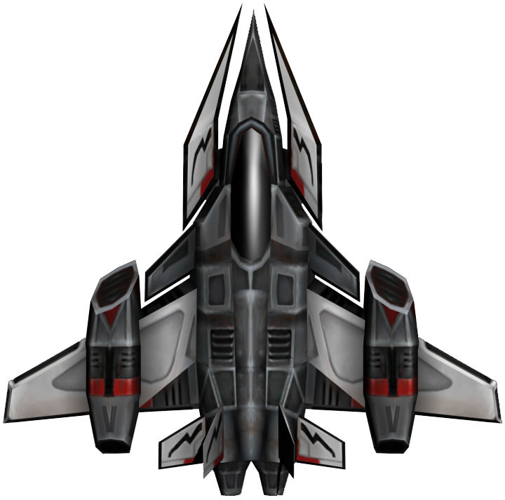


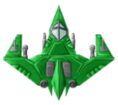
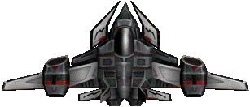


Slide 10
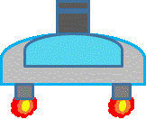


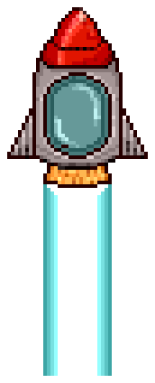
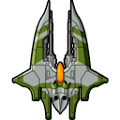

Slide 11



Slide 12


Slide 13


Slide 14


